Slide 1

Community Service Project External Viva-Voce Examination
“Disease Prediction System”
Team Members:
1) J. Subhashini, 21BQ1A0574.
2) K. Sudheeksha, 21BQ1A05A0.
3) K. Jahnavi, 21BQ1A05A1.
4) G. Dhana Lakshmi, 22BQ5A0508 .
Internal Guide:
Dr. P. Srinivas Rao
Associate Professor
Department of CSE (NBA Accredited),
Vasireddy Venkatadri Institute of Technology (Autonomous), Nambur, Pedakakani Mandal, Guntur Dist., Andhra Pradesh

Slide 2
INDEX
Abstract
Introduction
Survey Problems
Field work
Problem Statement
Technologies Used
Implementation and Result
Conclusion
References

Slide 3
ABSTRACT
This study proposes a robust disease prediction system utilizing machine learning algorithms to accurately forecast the onset of various diseases. By integrating extensive patient datasets, including demographic information, medical history, lifestyle factors, and genetic data, the system leverages supervised learning techniques to identify patterns and correlations indicative of potential health risks. Key methodologies employed include feature selection, data preprocessing, and model training using algorithms such as decision trees, support vector machines, and neural networks. The system's predictive accuracy is validated through cross-validation and real-world testing, demonstrating its potential to provide early warnings and personalized healthcare recommendations. The implementation of this machine learning-based disease prediction system aims to improve patient outcomes by facilitating early diagnosis, optimizing treatment plans, and ultimately reducing the burden of chronic diseases on healthcare systems.

Slide 4
Introduction
A community service project is an initiative undertaken by individuals or groups to address a specific need or issue within a community. These projects are typically aimed at improving the well-being, quality of life, or circumstances of community members.
Community service projects can take various forms and may involve activities such as:
Volunteer Work: Engaging in hands-on activities such as cleaning up parks, serving meals at homeless shelters, tutoring students, or providing companionship to elderly residents.
Fundraising: Organizing events or campaigns to raise funds for local charities, schools, or other community organizations that support important causes.

Slide 5
Awareness Campaigns: Creating and promoting initiatives to raise awareness about social, environmental, or health issues within the community, such as mental health awareness campaigns or recycling drives.
Skill-building Workshops: Offering workshops or training sessions to teach valuable skills to community members, such as financial literacy, job readiness, or computer skills.
Environmental Initiatives: Undertaking projects to protect and improve the environment, such as planting trees, cleaning up litter, or promoting recycling and conservation efforts.
Community Development Projects: Working on projects that aim to enhance the infrastructure or facilities within the community, such as building playgrounds, renovating community centers, or improving access to clean water.
Support Services: Providing support services to vulnerable populations within the community, such as organizing food drives, offering free healthcare clinics, or assisting with disaster relief efforts.

Slide 6
Community service projects can focus upon the following areas
1. Water facilities and drinking water availability
2. Health and hygiene
3. Stress levels and coping mechanisms
4. Health intervention programmes
5. Horticulture
6. Herbal plants
7. Botanical survey
8. Zoological survey
9. Marine products etc.

Slide 7
Survey Problems
Day / Week No | Activity Done | Learning outcome
1 | We went to the Peddakakani village center and observed the people there are doing every day chores and ask them about village | We study how people are involved in the work and adjusted to help others
2 | We visited to others peoples house and asked them how they are coping up with health conditions, and other situations they are facing. | We learned that people are facing several health issues due to several unhealthy activities.
3 | We visited to others peoples house and asked them how they are do agriculture, what they use to farm the land. | We learned how people are efficiently harnessing natural resources to farm the land
4 | We saw people are meeting at location near the farm to learn how they employ water usage for their crops from pond’s | We learned the we’ve to gathering to discuss ways to tackle our difficulties
5 | We encounter people near the end of the hamlet who have the capacity to work in factories and run their own business | We can simply learn that in village, people support each other even when they have limited work

Slide 8
6 | As we conducted our assessment, we identified a significant issue: limited access to healthcare facilities and medical services within the community. | Recognizing healthcare disparities led to efforts to enhance medical services and infrastructure, ensuring equitable access for all community members.
7 | As we surveyed in the village, we came to know that there are limited public transportation facilities and drainage is not cleaned regularly. There are only few RTC bus services available to Guntur from this village and most of the people rely on private vehicles to reach the nearest towns. | They are only RTC buses service available to guntur from the village and most of the people really on private vehicles to reach the nearest towns
8 | Conducted a health awareness workshop at the village focusing on preventive measures to overcome seasonal diseases | Empowered individuals with knowledge to improve personal and community health outcomes.
9 | Visited a community park in the village and planted some trees along the boundary of the park with a motive of increasing the greenery. | As trees are very essential for environmental sustainability, we requested the local people to take care of those plants by watering them daily and protect them.
10 | With all the surveys that we have done, we came to know that major problem in the village is improper Health Care due to less Primary Health Centers. So, we met the village government officials and explained the problem faced by people and requested for a speedy action. | If the Health Care problem is solved in the village, growth of illness will rapidly decrease and consequently all the citizens of the village should live a Healthier Life.

Slide 9
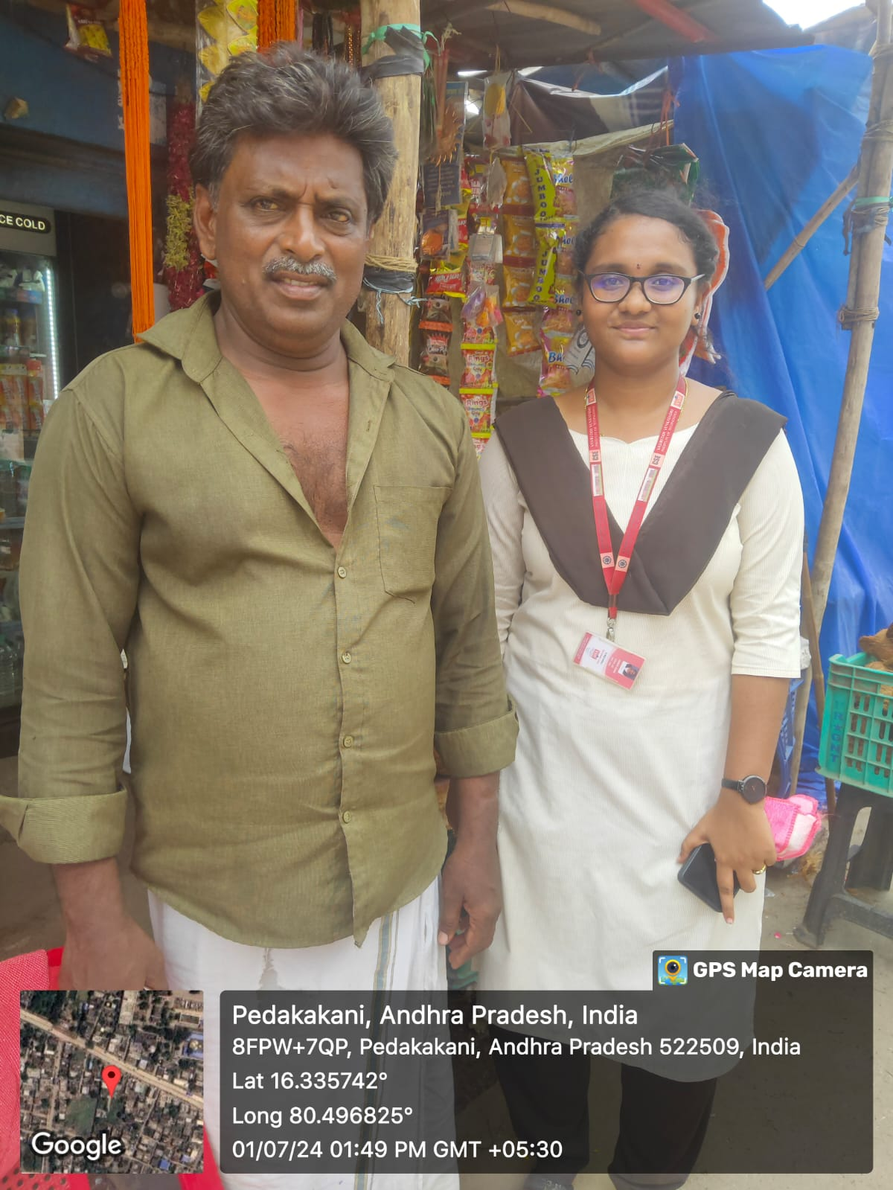
Field Work
Day 1:
Respondents Name : K.Karimulla
Age : 32
Education : Tenth
Major Source of Income : ShopKeeper
Children : 2 Daughters
Family Details : 1 male and 1 female
Family Income : approx. 2 lakhs
Notable Issues in the village : Stagnant Drainage water
Photo with the Respondent :

Slide 10
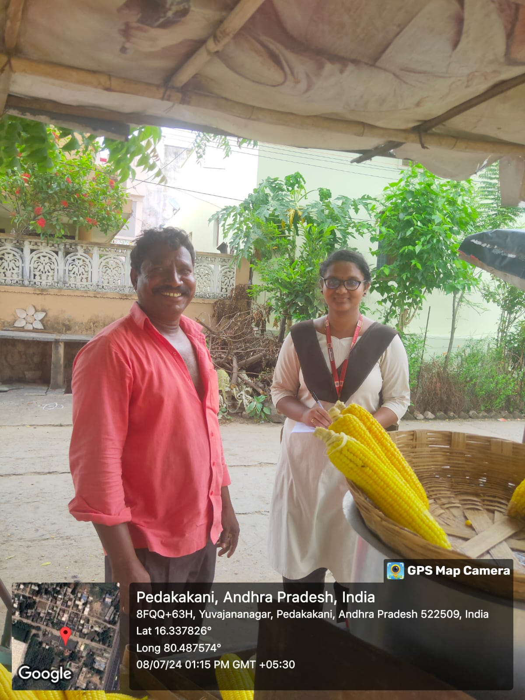
Day 2:
Respondents Name : K.Prasad
Age : 53
Education : N/a
Major Source of Income : Hotel Worker
Children : 2
Family Details : 2 Male and 2 Female
Family Income : approx. 1 lakhs
Notable Issues in the village : Transportation
Photo with the Respondent :

Slide 11
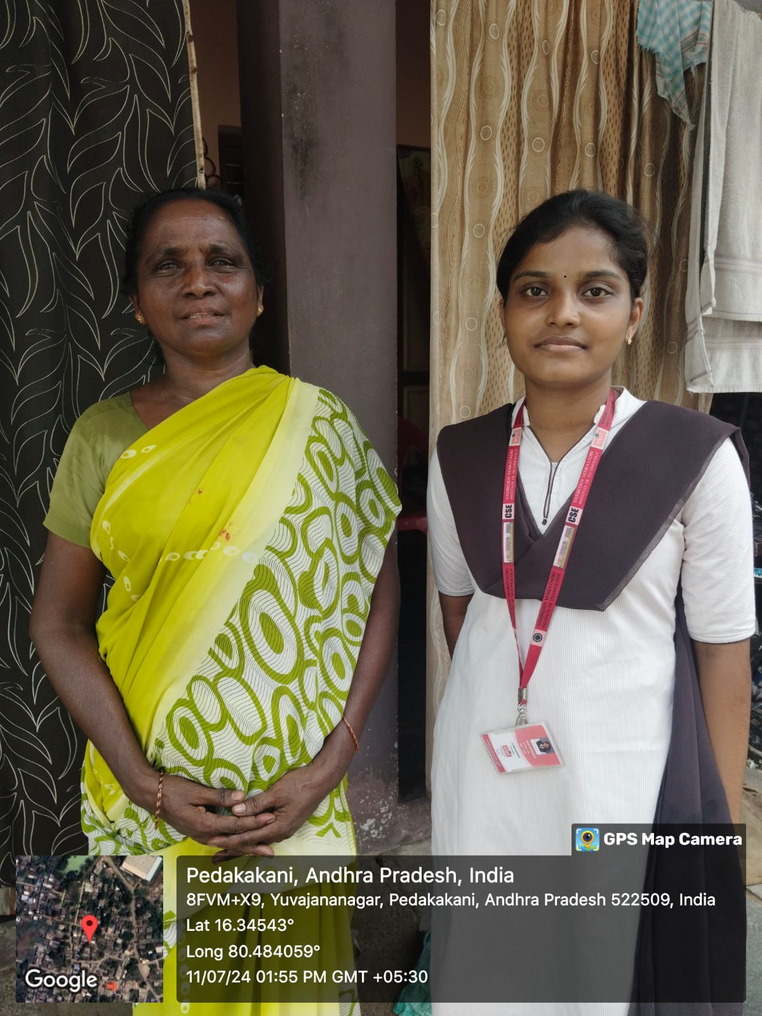
Day 3:
Respondents Name : S.Subbayamma
Age : 52
Education : N/A
Major Source of Income : Flower Shop
Children : 1 Daughter
Family Details : 1 male and 2 female
Family Income : approx. 2 lakhs
Notable Issues in the village : Irrigation Problem
Photo with the Respondent :

Slide 12
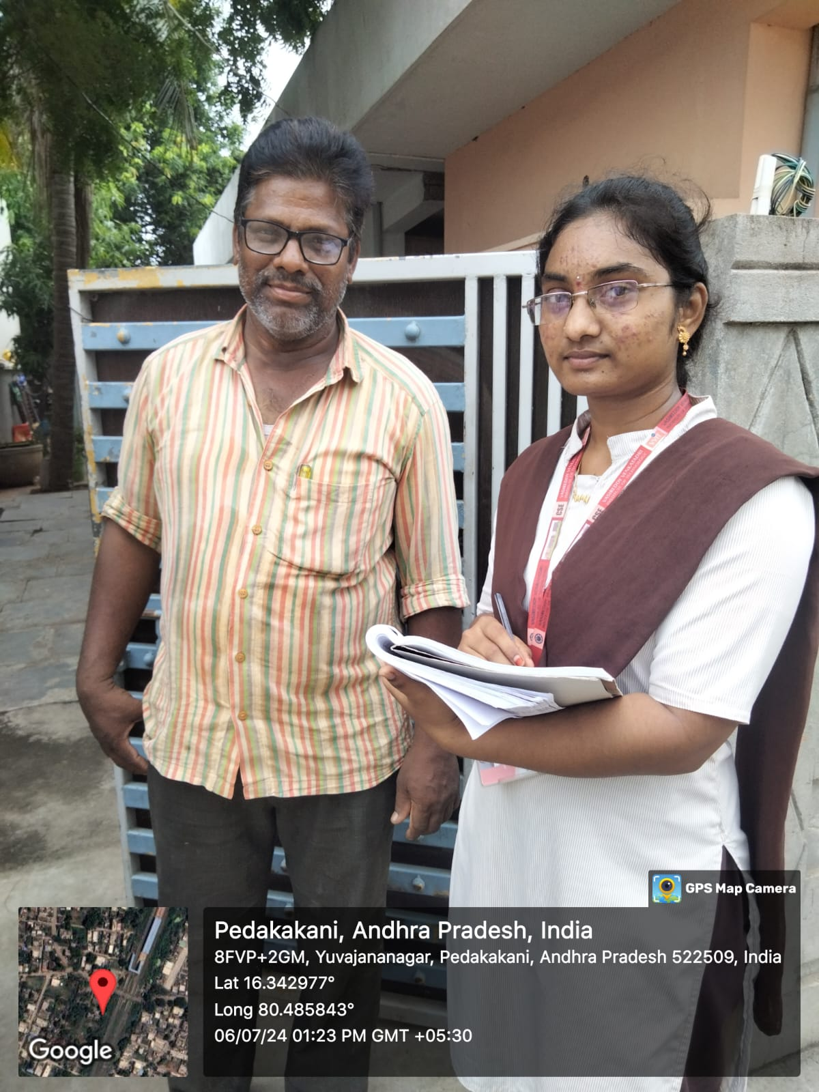
Day 4:
Respondents Name : T.Suresh Babu
Age : 47
Education : N/A
Major Source of Income : Electrician
Children : 1 Daughter
Family Details : 1 male and 2 female
Family Income : approx. 2.5 lakhs
Notable Issues in the village : Lack of Health care
Photo with the Respondent :

Slide 13
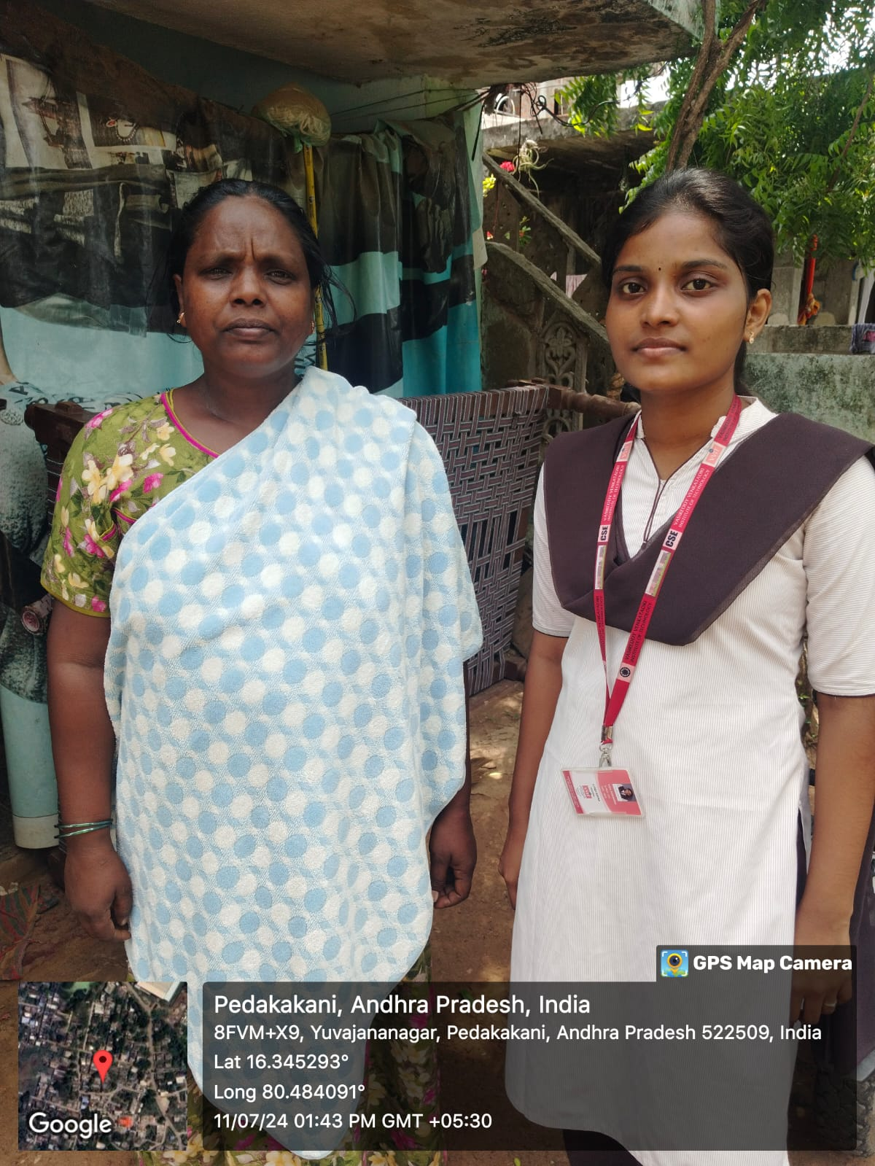
Day 5:
Respondents Name : Sk. Afrin
Age : 51
Education : N/A
Major Source of Income : Labour
Children : N/A
Family Details : 1 Female
Family Income : approx. 1 Lakh
Notable Issues in the village : Irrigation Problem
Photo with the Respondent :

Slide 14
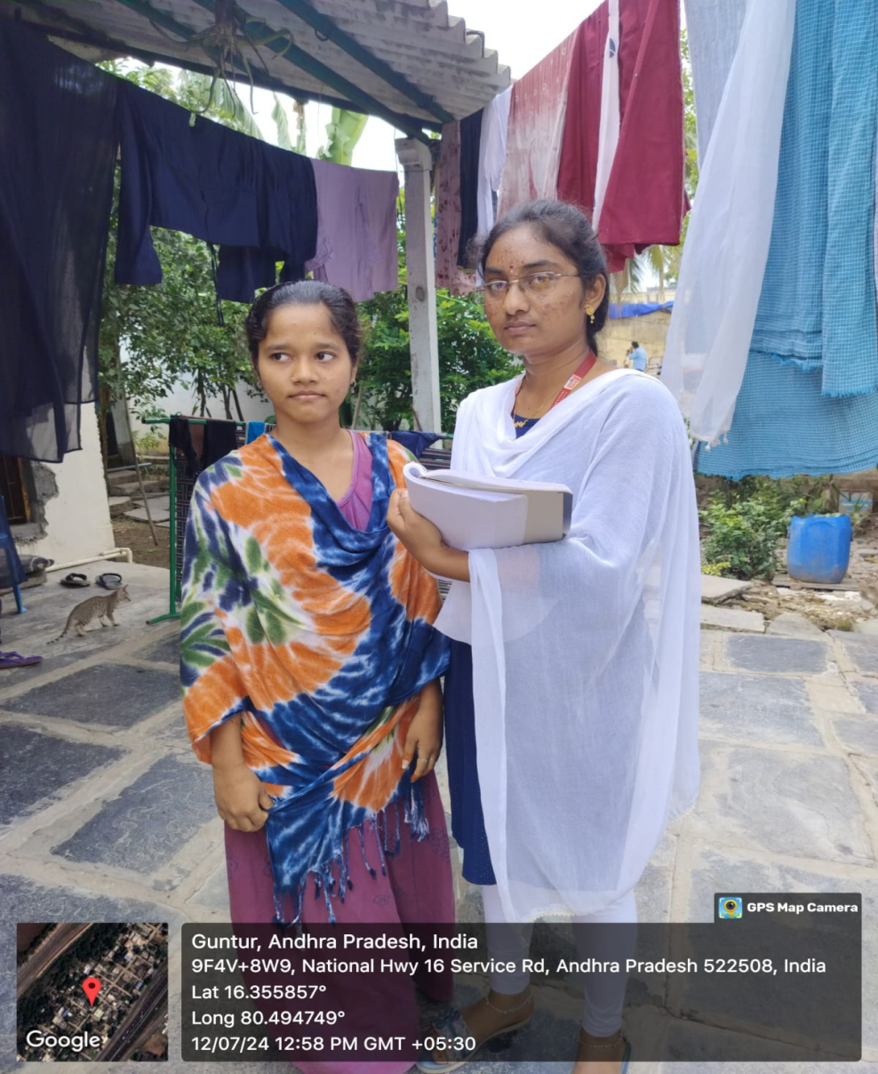
Day 6:
Respondents Name : M. Radha
Age : 19
Education : Inter
Major Source of Income : Employee
Children : 1 Son and 2 Daughters
Family Details : 2 male and 3 female
Family Income : approx. 4.5 lakhs
Notable Issues in the village : Stagnant Drainage water
Photo with the Respondent :

Slide 15
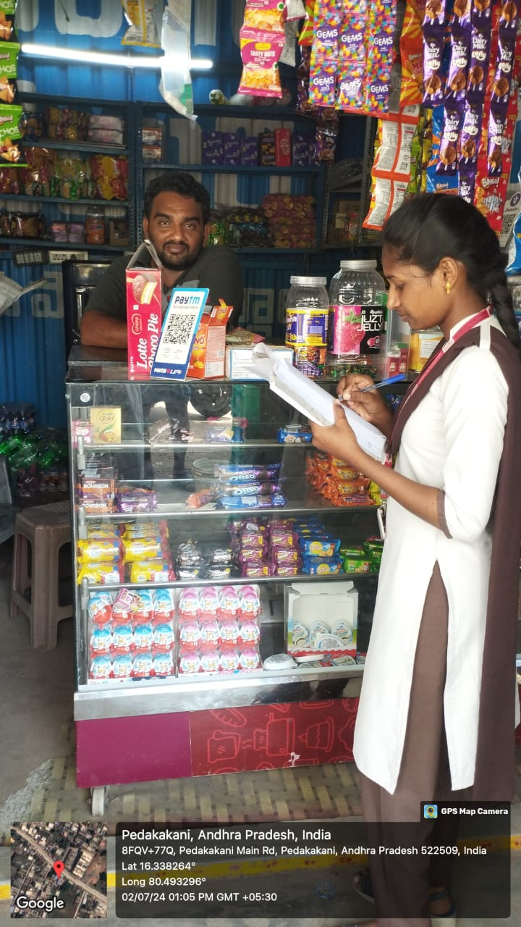
Day 7:
Respondents Name : B V Mohan Rao
Age : 52
Education : N/A
Major Source of Income : Shop keeper
Children : 1 Son and 1 Daughters
Family Details : 2 male and 2 female
Family Income : approx. 2.5 lakhs
Notable Issues in the village : Lack of Health care
Photo with the Respondent :

Slide 16
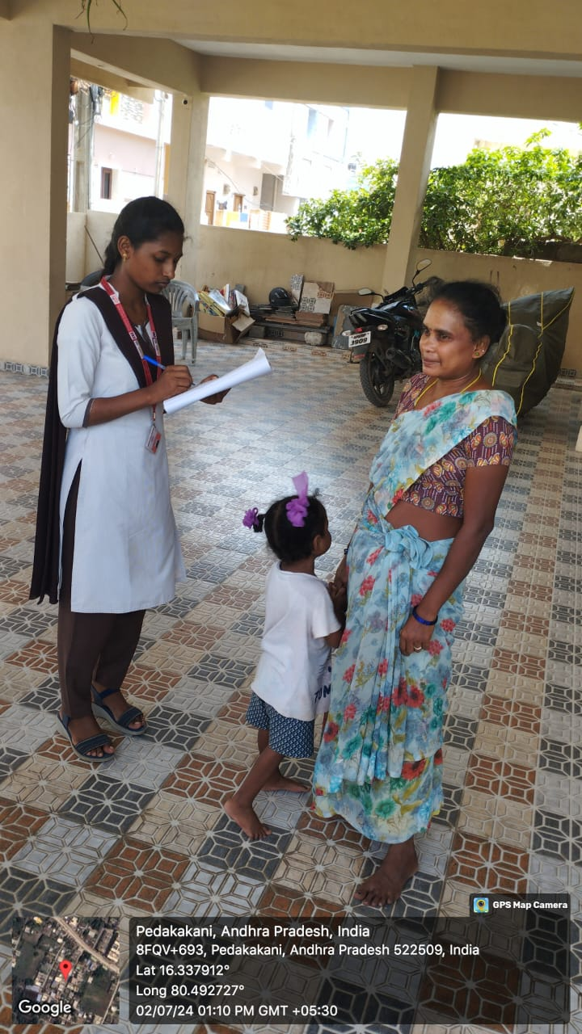
Day 8:
Respondents Name : Siva Parvathi
Age : 42
Education : N/A
Major Source of Income : Temple care Taker
Children : 1 Daughter
Family Details : 1 male and 2 female
Family Income : approx. 1 lakh
Notable Issues in the village : Improper Health Care
Photo with the Respondent :

Slide 17
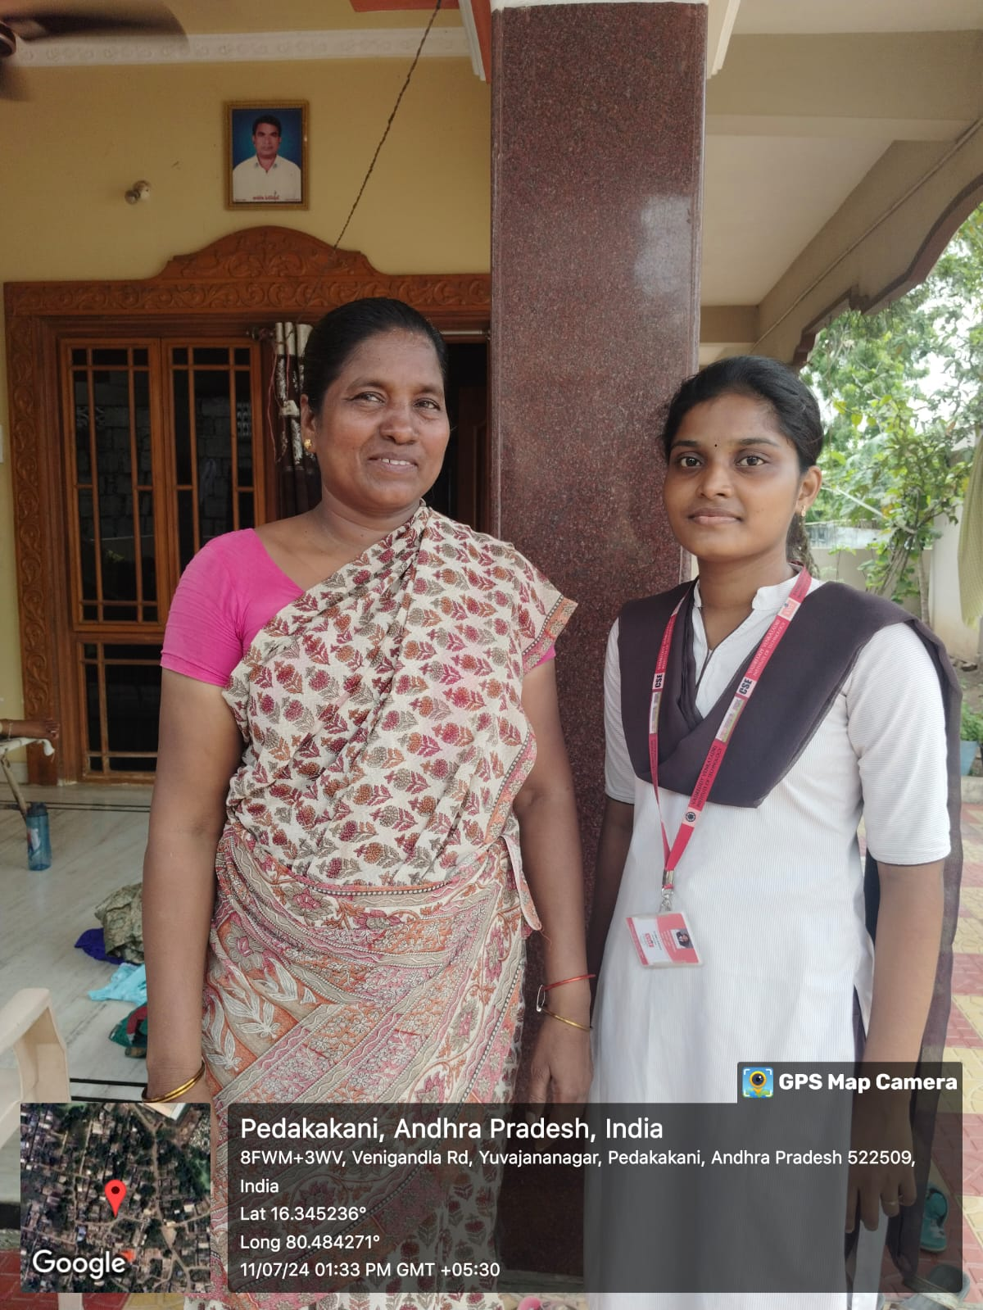
Day 9:
Respondents Name : Sri Lakshmi
Age : 37
Education : N/A
Major Source of Income : Labour
Children : 2 Sons
Family Details : 3 male and 1 female
Family Income : approx. 1.5 lakhs
Notable Issues in the village : Stagnant Drainage water
Photo with the Respondent :

Slide 18
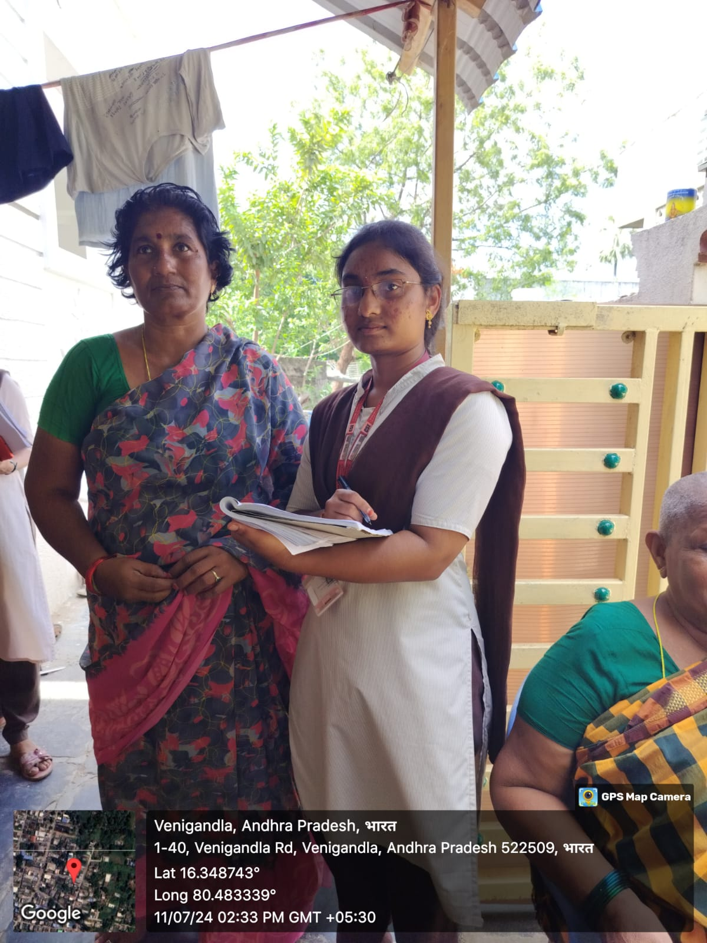
Day 10:
Respondents Name : Nikhila
Age : 43
Education : N/A
Major Source of Income : Agriculture
Children : 1 Daughter
Family Details : 1 male and 2 female
Family Income : approx. 1.8 lakhs
Notable Issues in the village : Improper Health Care
Photo with the Respondent :

Slide 19
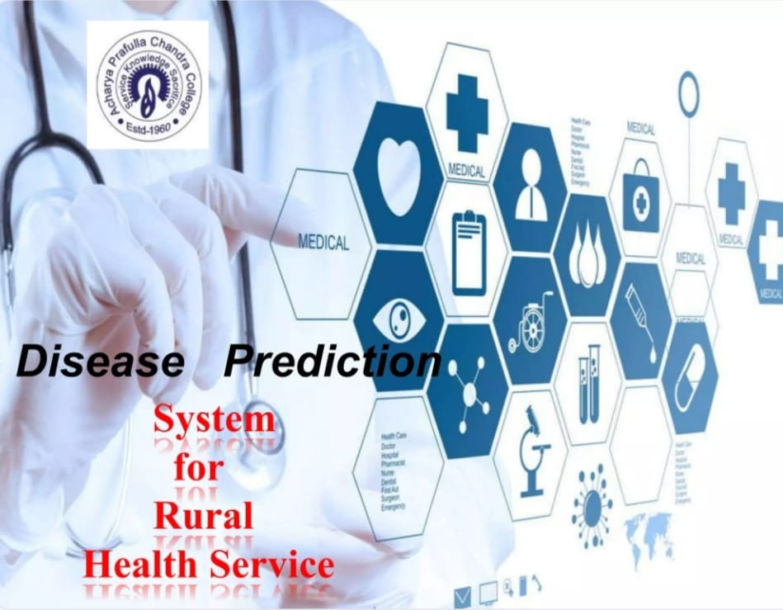
Problem Statement
Based on the above Field Survey we want to discuss and want to find a solution regarding the domain Disease prediction.

Slide 20
Technologies used
Programming Language:
Python – Used for scripting, data processing, and building the GUI-based disease prediction system.
Machine Learning Libraries:
Scikit-learn – Provides implementations of machine learning models (Decision Tree, Random Forest, Naïve Bayes) for classification.
Pandas – Used for handling and processing structured data from CSV files.
NumPy – Supports numerical computations and array operations essential for machine learning.
Tkinter – Python's standard library for building the graphical user interface (GUI).

Slide 21
Implementation
Data Preprocessing
Cleaned and pre-processed the collected dataset to handle missing values, remove duplicates, and encode categorical variables.
Conducted exploratory data analysis to gain insights into the distribution of symptoms and diseases within the dataset.
Model Development
Implemented the Random Forest algorithm using the Scikit-learn library for disease prediction.
Trained the model on the pre-processed dataset, optimizing hyperparameters such as the number of trees and maximum depth to improve predictive accuracy.
Evaluated the model's performance using cross-validation techniques and appropriate evaluation metrics.

Slide 22
User Interface Development
Designed an intuitive web-based user interface using React.js or Vue.js for front-end development.
Implemented features for users to input symptoms, view predicted diseases, and access personalized home care recommendations.
Incorporated interactive visualizations to display symptom patterns, disease descriptions, and recommended interventions.
Backend Development
Developed a backend server using Flask or Django to handle user requests, execute prediction algorithms, and serve recommendations.
Integrated the trained Random Forest model with the backend server to enable real-time disease prediction based on user input.
Implemented APIs to facilitate communication between the frontend user interface and the backend server.

Slide 23
Database Integration
Integrated a relational database management system (e.g., SQLite, PostgreSQL, MySQL) to store user data, symptom profiles, and predicted disease information.
Designed database schemas and implemented data access layers to interact with the database from the backend server.
Deployment and Testing
Deployed the application on a cloud platform (e.g., Heroku, AWS, Google Cloud Platform) to ensure accessibility and scalability.
Conducted thorough testing of the system's functionality, including unit tests, integration tests, and end-to-end tests.
Implemented continuous integration and continuous deployment (CI/CD) pipelines to automate testing and deployment processes.

Slide 24
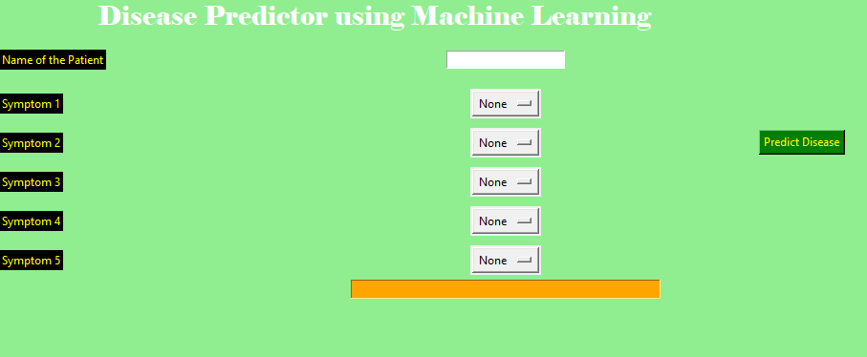
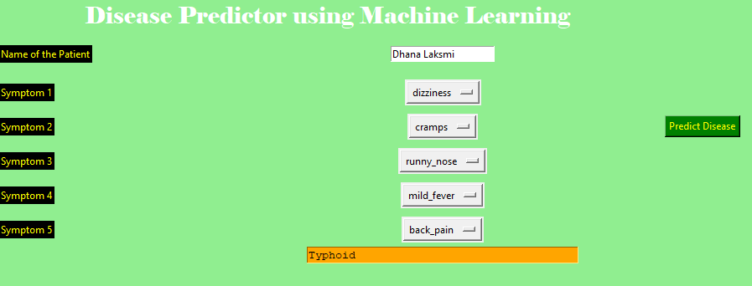
Results

Slide 25
Conclusion
In conclusion, Overcoming challenges in disease detection with machine learning requires addressing multiple factors to ensure accurate and reliable results. Improving data quality is essential, as high-quality, diverse datasets enhance model performance and reduce biases. Ensuring privacy and fairness in data collection and processing is crucial to maintaining ethical AI practices and preventing unintended discrimination. Model optimization through hyperparameter tuning and advanced architectures helps achieve higher accuracy and efficiency. Scalability is another key factor, allowing models to handle large-scale agricultural applications effectively. Regular updates and retraining ensure that models remain relevant to evolving plant diseases and environmental conditions. Seamless integration with existing agricultural technologies, such as IoT devices and drones, enhances real-time monitoring and early disease detection. Additionally, user training and awareness programs enable farmers and agricultural experts to utilize AI-driven solutions effectively. Collaboration between data scientists, agronomists, and policymakers fosters the development of holistic solutions tailored to real-world farming needs. By implementing these strategies, machine learning can significantly improve disease detection, reducing crop losses and ensuring food security. Ultimately, a well-structured AI system contributes to sustainable agriculture and long-term economic benefits for the farming industry.

Slide 26
References
Mohan, N., & Jain, V. (2020, November). Performance analysis of support vector machine in diabetes prediction. In 2020 4th International conference on electronics, communication and aerospace technology (ICECA) (pp. 1-3). IEEE.
Khourdifi, Y., & Baha, M. (2019). Heart disease prediction and classification using machine learning algorithms optimized by particle swarm optimization and ant colony optimization. International journal of Intelligent engineering & systems, 12(1).
Vijayarani, S., & Dhayanand, S. (2015). Liver disease prediction using SVM and Naïve Bayes algorithms. International Journal of Science, Engineering and Technology Research (IJSETR), 4(4), 816-820.
Mohan, S., Thirumalai, C., & Srivastava, G. (2019). Effective heart disease prediction using hybrid machine learning techniques. IEEE access, 7, 81542-81554.
Sriram, T. V., Rao, M. V., Narayana, G. S., Kaladhar, D. S. V. G. K., & Vital, T. P. R. (2013). Intelligent Parkinson disease prediction using machine learning algorithms. Int. J. Eng. Innov. Technol, 3(3), 1568-1572.
Monto, A. S., Gravenstein, S., Elliott, M., Colopy, M., & Schweinle, J. (2000). Clinical signs and symptoms predicting influenza infection. Archives of internal medicine, 160(21), 3243-3247.
Sreevalli, R. D. H. D. P., & Asia, K. P. M. (2020). Prediction of diseases using random forest classification algorithm. Zeichen J, 6(5), 2020.
Langbehn, D. R., Brinkman, R. R., Falush, D., Paulsen, J. S., Hayden, M. R., & an International Huntington's Disease Collaborative Group. (2004). A new model for prediction of the age of onset and penetrance for Huntington's disease based on CAG length. Clinical genetics, 65(4), 267-277.

